Slide 1
CCCA4 : Technical Sales Presentation Development of an application for the autocorrection of bank checks

Slide 2






Team Members
Youssef MANSOUR
Molka MRAD
Houssem OUERDIANE
Dhia BEN AMOR
Haithem GHARBI
Aicha CHAABA

Slide 3
Logo
01

Slide 4



Slide 5
Market Positionning
02

Slide 6

Problematic
Client
Bank Agent
Non-matching amount in letters and in numbers
Syntax Mistakes
Invalid date
Forgetting to fill a part of the check
Cross-outs
Unreadable handwriting
Diffrent types of checks
Different format of writing,dimesion,colors,police,language,…
Slow processing

Slide 7
Traditionnal Process
A bank agent responsible for the validation of the check
Long waiting lines
A complex procedure that takes a lot of time with very possible human mistakes

Slide 8
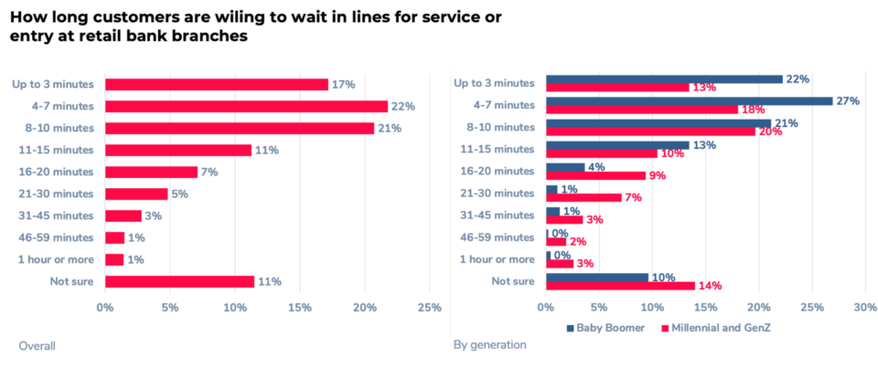

Slide 9
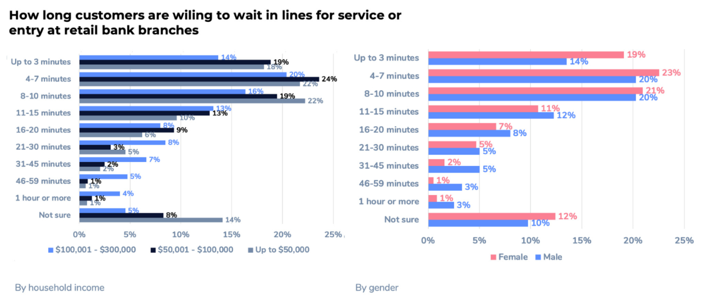

Slide 10
Competition
03

Slide 11
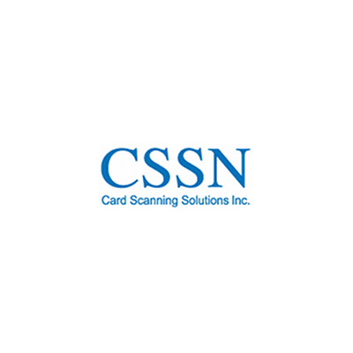


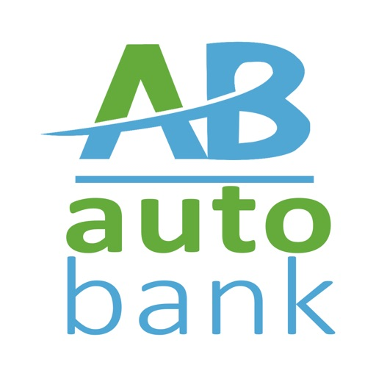
Competition

Slide 12
Competition
Advantages
Drawbacks
Show errors in the process
Integration of Artificial Intelligence
Saving rejected checks in the cloud for later treatement
Printing a reciept or a copy of the check
No Correction for writing mistakes
Rejection of the check in case of missing fields
Premium Applications

Slide 13
Promises & Potential
04

Slide 14
Client
Bank Agent
Automatic Identification of the diffrent parts of the check using Artificial Intelligence
Detection of anomalies
Classification of the checks by their validity
Notify the client about his account transactions
Graphical presentation of deposits and retreats
Suggestions regarding the client’s account balance
2-way Confirmation for the cashing of a check

Slide 15
Application’s Logo
05

Slide 16


Slide 17
Application’s features
06

Slide 18
Achieve the autocorrection of the amount in a check
Manipulate a huge amount of data
Assure the security in the whole process

Slide 19
Detection of the different parts of the check
Comparison between the amount in numbers and the amount in letters
Verifying the validity of the date (the check expires after 3 years and a week)

Slide 20
Check the existence of the signature and its validity
Identify the language written in the check
Identify different handwritings

Slide 21
Process’s Description
07

Slide 22

The process
01
02
03
04
The client walks in the bank and inserts his check in an ATM-like machine
The screen on the machine shows different details about the transaction such as the client’s balance, the reciever’s name,...
The client confirms the deposit of the check
The machine prints a reciept and memorizes the process in the server’s cloud

Slide 23
Application’s Poster
08

Slide 24


Slide 25
Application’s Flyer
09

Slide 26


Slide 27
Advertising Strategies
10

Slide 28

Formations
Communication Boxes
Seminars
Events
Advertising Strategies

Slide 29
Communication’s Channels
11

Slide 30


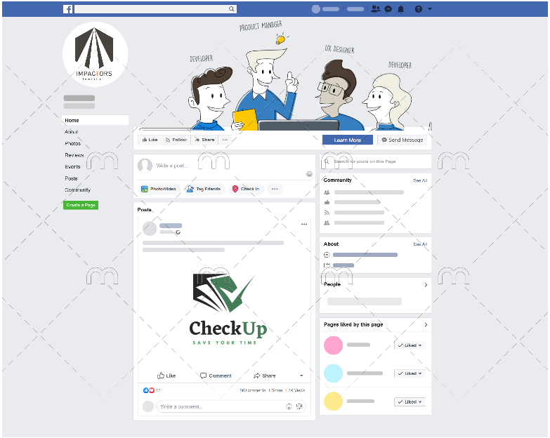




Contact Us
Impactors
Impactors
http://www.impactors.tn
+216 72 500 315
Ariana, Ghazela

Slide 31
Call To Action
12

Slide 32


Check us out ! And if you have any questions , please don’t hesitate.

Slide 33
Potential Risks & Risk Management
13

Slide 34

Potential Risks
Confidentiality of bank clients
Diversity of check layouts
Budget limits
Security of the system
High-availability of the server

Slide 35
Testimonials
14

Slide 36


Ines : Bank Client
Before using the application , I had to stand in line in the bank for a long time to wait for my order to deposit a check and now the whole process only takes a few minutes
Ahmed : Bank Agent
Before our bank deployed the application , we had to automatically sort the checks and control them , it was a long and painful process and mistakes were often made.
Now thanks to the application , we no longer need to do this, everything is done automatically using AI.

Slide 37
Thanks!
Do you have any questions?

